Slide 1
Chapter Summary
Sets（集合）
The Language of Sets
Set Operations
Set Identities
Functions（函数）
Types of Functions
Operations on Functions
Computability
Sequences（序列） and Summations（求和）
Types of Sequences
Summation Formulae
Set Cardinality（基数）
Countable Sets
Matrices
Matrix Arithmetic

Slide 2
Introduction
Sets are one of the basic building blocks for the types of objects considered in discrete mathematics.
Important for counting.
Programming languages have set operations.
Set theory is an important branch of mathematics.
Many different systems of axioms have been used to develop set theory.
Here we are not concerned with a formal set of axioms for set theory. Instead, we will use what is called naïve set theory.
朴素集合论
Notes:
https://zhuanlan.zhihu.com/p/633885698 集合介绍

Slide 3
集合的历史
Georg Cantor (康托)
The history of set theory: one person, Georg Cantor
Most most other areas of mathematics: a group envolves
对角线法:
康托用对角线法证明了实数集与自然数集不等势，从而在历史上第一次提出“无穷集合也存在不同的大小”这种观点，由此才产生出后来的公理集合论。 现代集合论其实就是对无穷集合的研究
“不可数集”这个概念大概也就一百多年的历史
在柯西或者傅立叶的时代，没什么“不可数集”“连续统假设”概念
Notes:
出生于俄国的德国数学家
845年3月3日，康托尔出生在俄国的圣彼得堡，他是个犹太人，但是他们全家都是基督徒，这可能也是后来康托尔性格有些分裂的原因。康托尔12岁的时候，他们全家搬去了德国，到他15岁的时候，他的数学天赋已经显露了出来，他想成为一个数学家，但是他的父亲强迫他学习工程。康托尔不像黎曼那样去跟自己的父亲据理力争，而他的父亲也不像黎曼的父亲那样善解人意，康托尔只是顺从地按照父亲选的道路去前进。这又是康托尔性格中软弱的地方，他总是对自己很不自信，总是希望通过自己的改变来取悦别人。所以后来克罗内克恶毒攻击他的集合论的时候，康托尔不是想办法去争锋相对，而是开始怀疑自己的价值。这也是造成他后来精神分裂的原因之一。

Slide 4
集合的历史
从无理数的产生开始，直到十九世纪，两千多年，人们对于无穷这个概念却是能避则避。直到我们最伟大的数学家之一——康托尔的出现
实数点集：集合的开端
康托尔意识到无穷集合的重要性，勇敢的选择了大家避之不及的无穷进行研究。这期间他的论证不断受到各个数学家的质疑和否定，康托尔甚至曾经几度被批判到精神崩溃住进精神病院疗养。
1897年，在瑞士苏黎世召开的第一届国际数学家大会上，康托尔的集合论被其他两位数学家明确阐述对他们的工作起到巨大的推动作用。至此，集合论才开始慢慢被人们接受，从而取代几何成为现代数学的基础。
德国著名数学家希尔伯特曾高度赞誉康托尔的集合论"是数学天才最优秀的作品"，"是人类纯粹智力活动的最高成就之一"，"是这个时代所能夸耀的最巨大的工作"。

Slide 5
朴素集合论
集合论发轫于分析的严密化运动。十九世纪后期，因追寻实数的坚实基础及突变函数性质研究的需要，孤立地研究实数轴上某个点或某个数的方式被代之以将各点联系在一起作为整体研究。这就形成了能把握实数的精确结构及性质的“点集论”。
德国数学家康托尔（Georg Cantor）是集合论的创立者。1872 年，他在《数学年鉴》上发表的论文引进极限点、导集等概念， 从而奠定了“点集论” 的基础。
1874年，他在《数学杂志》上又 发表了关于无穷集合理论的论文；此后发表的一系列论著进一步阐明了他的集合论思想。

Slide 6
朴素集合论
康托尔在集合论上的主要贡献有：
明确给出了集合的定义，以及集合的并、交等运算；
提出无穷集的势等概念，通过一一对应关系建立了集合大小的比较原则，给出了无穷集的分类法；
建立了基数和序数的理论；
证明了超越数的存在；
他所提出的连续统假设，至今未能获得圆满解决。
集合论的建立开辟了数学研究的一个全新领域，是数学发展的一个里程碑，它不仅回答了“什么是数” 、“什么是无限”这两个哲学家和数学家都迫切需要解决的问题，而且为数学奠定了坚实的基础，对整个现代数学结构产生了重大和深远的影响。

Slide 7
康托尔的集合论为数学分析建立了基础，据此，严格的实数理论建立起 来了：
集合论第一次把哲学中的无穷概念变成为精确数学研究的对象，把数学从潜无穷的观点转到实无穷的观点上来，树立了一种全新的数学传统。
集合论的创立标志着一个数学新时代的开始。在集合论刚建立的时候，集合论的重要性仅仅为少数几个数学家所赏识。然而在其进一步发展中，集合论渗透到了几乎所有的数学分支，对这些数学分支的发展有着深远的影响，还改变那些已经确立的理论的面貌。
集合论的思想导致了对数学基础更为深刻的分析，对数学概念之间的相互关系以及各种理论结构的探讨，对数学证明和数学理论证明方式的审查。
集合是抽象思维的产物。在集合论中，集合被用来表示抽象事物的聚集。而从认识论角度上看，集合本质上又可视为描述人脑对客观事物进行识别和分类的一种抽象方法。正是由于这种方法的普遍性，使得集合成为数学抽象最有力的工具。

Slide 8
康托尔的集合定义(Cantor,1874)：
从集合的定义来看，集合、元素都是泛指，或说是抽象的，因此，不仅数、点、形，世界的各种事物无不可以按某种属性或关系的比较加以类聚。数学可以舍弃这些类聚事物的质的规定性，而使用各元素的集合对不同事物群的结构共性给予抽象、概括。
从集合观点看，数学概念都可以看成集合，因此，数学概念都可以用集合来表述，用揭示概念外延的方式定义概念实际上就是给出集合的元素，用揭示概念内涵的方式定义概念实际上就是给出集合中元素所满足的性质。
不论哪一门数学，开宗明义，总得有自己的研究对象，这些研究对象就形成一个集合或一些集合。因此，每门数学都用得上集合论。

Slide 9
康托尔的集合定义(Cantor,1874)：
集合概念是对数学所研究的各种对象的抽象概括。把一般的集合作为现代数学的研究对象，就能将数学的各个不同领域统一起来，成为各个数学分支的基础，同时也极大地扩大了数学的范围。
因此，在现代数学里，研究对象就不再是数和形这两大传统、经典的研究领域，而是一般的集合、各种空间和流形。它们都能用集合和映射的概念统一起来， 已很难区分哪些属于数的范畴，哪些属于形的范畴。
同样地，超穷数也是抽象思维的产物。跟有穷数一样，超穷数也是从真实的集合中抽象出来的。
康托尔指出，集合的基数是两次抽象的结果：一次是从对象中抽去它们所具有的质的特性， 另一次则是抽去在对象之间所存在的次序关系；（良序）集合的序数则是一次抽象的结果，即是从对象中抽去了它们所具有的质的特性。

Slide 10
2.1 Sets
Some Concepts of Sets
【Definition】A set is an unordered collection of objects.
【Definition】The objects in a set are called the elements, or
members, of the set.
A set is said to contain its elements.
Note:
Uppercase letters are usually used to denote sets, and lowercase letters are usually used to denote elements of sets.
a ∈ A: a is a member (an element) of the set A
a ∉ A: a is not an element of the set A

Slide 11
2.1 Sets
The descriptions of a set
One can describe a set by
Roster method: listing all its members between braces
For example,
The set of all odd positive integers less than 10 can be expressed by {1,3,5,7,9}
(2) S = {a, b, c, d}
Brace notation with ellipses
For example,
The set S of positive integers less than 100 can be
denoted by S = {1, 2, 3, . . . , 99 }

Slide 12
2.1 Sets
Specification using set builder
S= {x| P(x)}
---- S contains all the elements from U which have the property P.
Universal set U:
----The set contains all the objects under consideration.
For example,
{x | x is an odd positive integer less than 10}

Slide 13
2.1 Sets
Venn diagrams
In Venn diagrams, the universal set U is represented by a rectangle.
Inside this rectangle, circles or other geometrical figures are used to represent sets.
Points are used to represent the particular elements of the set.
U
A
B

Slide 14
2.1 Sets
Note:
The Order of elements does not matter.
{1, 2, 3} = {3, 2, 1}
Repetition of elements does not matter.
{1, 1, 2, 3, 3} = {1, 2, 3}
〖Example 1〗Several sets and their notations are used throughout this book.
(1) R = {x | x is a real number}
(2) N = { x | x is a natural number}
(3) Z = { x | x is an integer}
(4) Z⁺ = { x | x is a positive integer}
(5) φ -- The void set / null set / empty set

Slide 15
2.1 Sets
The relations between two sets
① Subset
A⊆B ---- A is a subset of the set B.
A⊆B ⇔ ∀x (x ∈A → x ∈B)
Problems:
For any set A,
(1) φ ⊆ A?
Y.
The empty set is a subset of any set.
(2) A ⊆ A?
Y.

Slide 16
2.1 Sets
② Equal
A = B ⇔ ∀x[(x ∈A→ x ∈B) ∧ (x ∈B→ x ∈A)]
〖Example 2〗S1 = {a, b, c, d}, S2= {a, d, b, c}, S3={b, c, a, d, d} .
S1 = S2 = S3?
③ Proper subset
A⊂B ⇔ ∀x (x∈A → x∈B) ∧ ∃x(x∈B∧x∉A)

Slide 17
2.1 Sets
【Definition 】 Let S be a set. If there are exactly n distinct elements in S where n is a nonnegative integer, we say that S is a finite set and that n is the cardinality of S.
Notation:
∣S∣---- the cardinality (基数) of S
【Definition 】A set is said to be infinite if it is not finite.
For example,
The set of positive integers is infinite.
〖Example 3〗
(1) Let A be the set of odd positive integers less than 10. Then︱A︱=?
(2) ︱φ︱ = ?

Slide 18
2.1 Sets
2. The power set
〖Example 4〗 Let , find all subsets of the set A.
Solution:
φ
{a},{b},{c}
{a, b},{b, c},{a, c}
{a, b, c}
Problem: How many subsets of the set A are there?
In general, for a set A with n elements, the number of subsets is

Slide 19
2.1 Sets
【Definition 】Given a set S, the power set of S is the set of all subsets of the set S.
Notation:
P(S) ---- the power set of S.
Note:
(1) |S|=n implies |P(S)| = 2^{n}
(2) S is finite and so is P(S).
(3)

Slide 20
2.1 Sets
〖Example 5〗 What is the power set of the set ?
Solution:

Slide 21
2.1 Sets
〖Example 6〗 Show that ?
Proof:
Problem:

Slide 22
2.1 Sets
3. Cartesian Products
【Definition 】The ordered n-tuple (a₁,a₂,…,a_{n}) is the ordered collection that has a₁ as its first element, a₂ as its second element, … , and a_{n} as its nth element.
(a₁, a₂, …,a_{n}) =(b₁, b₂, …, b_{n}) ⇔ a_{i} = b_{i} (i=1,2,…, n)
In particular, 2-tuples are called ordered pairs.
Note:
If ，then .

Slide 23
2.1 Sets
The Cartesian product of A and B:
The Cartesian product of A₁, A₂, … , A_{n} :
A₁×A₂×…×A_{n} = {(a₁, a₂, …, a_{n})∣a_{i}∈A_{i} for i=1, 2, …., n}.

Slide 24
2.1 Sets
〖Example 7〗 ,
solution:
Note:
If |A|=m, |B|=n, Then

Slide 25
2.1 Sets
5. Truth Sets of Quantifiers
Given a predicate P, and a domain D.
The truth set of P is the set of elements x in D for which P(x) is true. namely,
The truth set of P = {x ∈D | P(x) }

Slide 26
CHAPTER 2
Basic Structures: Sets, Functions, Sequences, and Sums
2.1 Sets
2.2 Set Operations
2.3 Functions
2.4 Sequence and Summations
2.5 Cardinality of Sets

Slide 27
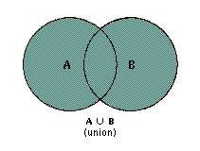
2.2 Set Operations
1. Set Operations
1) Union
According the Venn diagram,

Slide 28
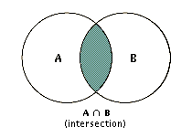
2.2 Set Operations
2) Intersection
According the Venn diagram,
Two sets are called disjoint if their intersection is the empty set, namely
A∩B = Ø

Slide 29
2.2 Set Operations
The cardinality of the union of two finite sets:

Slide 30
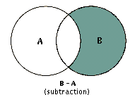
2.2 Set Operations
3) Difference of A and B
B
A
A – B

Slide 31
2.2 Set Operations
4) the complement of a set
A
Where U is the universal set
Note:
5) Symmetric difference

Slide 32
2.2 Set Operations
3. Set Identities
Set Identities
Identity | Name
A ∪ ∅ = A, A ∩ U = A | Identity laws
A ∪ U = U, A ∩ ∅ = ∅ | Domination laws
A ∪ A = A, A ∩ A = A | Idempotent laws
 | Complementation law
A ∪ B = B ∪ A, A ∩ B = B ∩ A | Commutative laws
A ∪(B ∪ C) = (A ∪ B) ∪ C A ∩(B ∩ C) = (A ∩ B) ∩ C | Associative laws
A ∩(B ∪ C) =(A ∩ B) ∪(A ∩ C) A ∪(B ∩ C) =(A ∪ B) ∩(A ∪ C) | Distributive laws
 | De Morgan’s laws

Slide 33
Four ways to prove set identities
New & important
Show that A ⊆ B and that A ⊇ B.
Use logical equivalences to prove equivalent set definitions.
Use a membership table.
Use previously proven identities.
Not hard, a little tedious
Like truth tables
Like ≡

Slide 34
2.2 Set Operations
〖Example 1〗 Show that ?
solution:
(1) C = D iff C ⊆ D and D ⊆ C
Suppose that .
It follows that .
This implies that .
Hence, .
Thus .
(detail omitted)
Q.E.D.

Slide 35
2.2 Set Operations
〖Example 1〗 Show that ?
solution:
(2) Use set builder notation and logical equivalences

Slide 36
2.2 Set Operations
〖Example 2〗 Let A, B, and C be sets. Show that
Membership Table
A | B | C | B∪C | A∩(B∪C) | A ∩ B | A ∩ C | (A ∩ B) ∪(A ∩ C)
1 | 1 | 1 | 1 | 1 | 1 | 1 | 1
1 | 1 | 0 | 1 | 1 | 1 | 0 | 1
1 | 0 | 1 | 1 | 1 | 0 | 1 | 1
1 | 0 | 0 | 0 | 0 | 0 | 0 | 0
0 | 1 | 1 | 1 | 0 | 0 | 0 | 0
0 | 1 | 0 | 1 | 0 | 0 | 0 | 0
0 | 0 | 1 | 1 | 0 | 0 | 0 | 0
0 | 0 | 0 | 0 | 0 | 0 | 0 | 0

Slide 37
2.2 Set Operations
〖Example 3〗 Show that ?
solution:

Slide 38
2.2 Set Operations
〖Example 4〗 Simplify the following set.
solution:

Slide 39
A ∩ B = ∅
〖Example 5〗Proof that if (A - B) U (B - A) = (A U B) then ______
Proof:
Suppose to the contrary, that A ∩ B ≠ ∅, and that x ∈ A ∩ B.
Then x cannot be in A-B and x cannot be in B-A.
Then x is not in (A - B) U (B - A).
But x is in A U B since (A ∩ B) ⊆ (A U B).
A U B = ∅
A = B
A ∩ B = ∅
A-B = B-A = ∅
Thus, A ∩ B = ∅.

Slide 40
2.2 Set Operations
4. Generalized Unions and Intersections

Slide 41
2.2 Set Operations
5. Computer Representation of Set
Using bit strings to represent sets.
Specify an arbitrary ordering of the elements of U,
for instance
(2) Represent a subset A of U with the bit string of length n, where the ith bit is 1 if belongs to A and is 0 if does not belong to A.
Union: bitwise OR
Intersection: bitwise AND

Slide 42
2.2 Set Operations
〖Example 5〗 Let U ={1, 2, 3, 4, 5,6,7,8,9}, A={1, 2, 3, 4, 5}, B= (1, 3, 5, 7, 9). Use bit strings to find the difference of A and B.
solution:
The bit string for the set A: 11 1110 000
The bit string for the set B: 10 1010 101

Slide 43
8th version
Homework (Due on Mar 18)
Sec. 2.1 13, 20, 24, 26, 34(a),(c)
Sec. 2.2 19, 54, 63(c)

Slide 44
CHAPTER 2
Basic Structures: Sets, Functions, Sequences, and Sums
2.1 Sets
2.2 Set Operations
2.3 Functions
2.4 Sequence and Summations
2.5 Cardinality of Sets

Slide 45
Section Summary
Definition of a Function.
Domain（定义域）, Codomain（陪域）
Image（像）, Preimage （原像）
Injection（单射）, Surjection（满射）, Bijection（双射）
Inverse Function（反函数）
Function Composition（函数复合）
Graphing Functions
Floor, Ceiling, Factorial
Partial Functions (optional)

Slide 46
函数的变迁史
解析函数、真函数和伪函数，再取消自变量为数的限制、引入集合
起源，1692年的论文中，莱布尼茨定义的函数：曲线上点的横坐标，纵坐标，切线的长度，垂线的长度等，凡与曲线的点有关的量，称为函数。
第一次：约翰·伯努利：由一个变量x与常数构成的任意表达式，称为x的函数。欧拉把这种表达式称为“解析函数”，并进一步区分为“代数函数”和“超越函数” -初高中
第二次，傅里叶，纠正了“真函数”和“伪函数”的概念
第三次，柯西的定义：若对x的每个值，都有完全确定的y值与之对应，则称y是x的函数。连续函数的精确定义。但柯西认为，x和y的函数关系，是可以用若干个解析式表示的。数学分析
第四次，狄利克雷的函数定义：若对x的每个值，有完全确定的y值与之对应，不管建立起这种对应的方式如何，都称y是x的函数。
Notes:
狄利克雷描述了一个特殊的函数f(x)：f(x)在x为有理数时总为1，在x为无理数时总为0。该函数对一切x都不连续，很难用一个或若干个式子来表。
函数概念从最初的“幂”或“几何学上的量”，先后经历解析函数、真函数和伪函数，再取消自变量为数的限制、引入集合，使得函数的概念越来越宽泛

Slide 47
函数的变迁史
第五次，取消了对自变量变域的限制，与集合论相结合。
第六次，突破了数的范围，维布伦和伦内首先使用了变量、常量的定义。维布伦给出了函数的新定义：若在变量y的集合与另一变量x的集合之间有这样的关系成立，即：对x的每一个值，有完全确定的y值与之对应，则称变量y是变量x的函数。
第七次，就是所谓的“集合函数”：设u是由许多集合构成的集合。若对u的每个元素A(A本身也是一个集合），另一集合B中都有完全确定的元素B与之对应，则称集合B是集合u的集合函数。泛函
多值函数、复变函数、可列无限个独立变量的函数，以及由这些函数构成的函数等。

Slide 48
2.3 Functions
【Definition】 Let A and B be nonempty sets. A function (mapping or transformations) f from A to B:
f : A→B
∀a(a ∈A → ∃!b (b ∈B ∧ f (a)=b))
A is called the domain of f , B is called the codomain of f .
f(a) = b
b is called the image of a under f
a is called a preimage of b
f(A): the range of f is the set of all images of elements in A under f.
If f is a function from A to B, we say that f maps A to B.

Slide 49
〖Example 1〗Suppose that each student in a class is assigned a letter grade from the set {A,B,C,D,F}. Let g be the function that assigns a grade to a student.
Zhao
Qian
Sun
Li
Zhou
A
B
C
D
F
Domain
Codomain
Range

Slide 50
2.3 Functions
【Definition】 Let f₁ and f₂ be functions from A to R. Then f₁ + f₂ and f₁f₂ are also functions from A to R defined by
(f₁ + f₂)(x) = f₁(x)+ f₂(x)
(f₁f₂)(x) = f₁(x) f₂(x)
【Definition】 Let f be a function from A to B and let S be a subset of A. The image of S is the subset of B that consists of the images of the elements of S. We denote the image of S by f(S), so that
f (S) = { f(s) | s∈S }
f(∅) = ∅
f({a}) = {f(a)}
f(A U B) = f(A) U f(B)
f(A ∩ B) ⊆ f(A) ∩ f(B)

Slide 51
2.3 Functions
The Graphs of Functions
Let f be a function from the set A to the set B. The graph of the function f is the set of ordered pairs
{(a, b)∣a∈A and f (a) = b}.
〖Example 2〗 Display the graph of the function f(x) = x² from Z to Z.
(-2,4)
(2,4)
(-1,1)
(1,1)
(0,0)

Slide 52
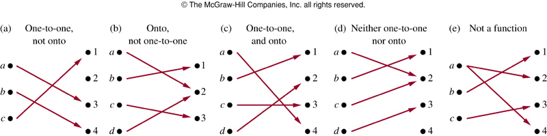

Slide 53
2.3 Functions
One-to-One and Onto Functions
1) One-to-One Functions
A function f is one-to-one (denoted 1-1), or injective
Note:
This means that if x ≠ y then f(x) ≠ f(y).
A function is said to be an injection if it is 1-1.
Notes:
单射

Slide 54
〖Example 3〗Determine whether the function f from {a, b, c, d} to {1, 2, 3, 4, 5} with f(a) = 4, f(b) = 5, f(c) = 1, and f(d) = 3 is one-to-one.
a
1
b
2
3
c
4
d
5
Questions:
f(x) = x² from the set of integers to the set of integers
f(x) = x+1
X
√

Slide 55
2.3 Functions
2) Onto Functions
A function f from A to B is called onto, or surjective
Note:
This means that for every b in B there must be an a in A such that f(a) = b.
Every b in B has a preimage.
A function is called a surjection if it is onto.

Slide 56
2.1 Sets
〖Example 4〗 Let f be the function from {a, b, c, d} to {1, 2, 3} defined by f(a) = 3, f(b) = 2, f(c) = 1, and f(d) = 3. Is f an onto function?
a
1
b
2
c
d
3
Questions:
f(x) = x² from the set of integers to the set of integers
f(x) = x+1
X
√

Slide 57
2.3 Functions
3) One-to-one Correspondence Functions
The function f is a one-to-one correspondence, or a bijection, if it is both one-to-one and onto.
For example,
a
1
b
2
c
3
Note:
Whenever there is a bijection from A to B, the two sets must have the same number of elements or the same cardinality.

Slide 58
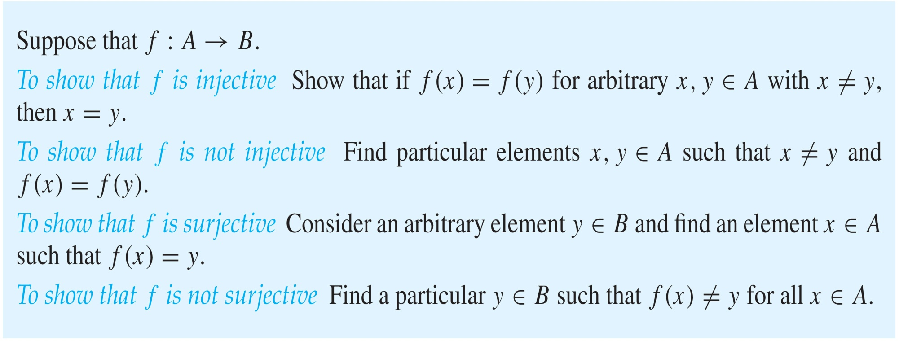
Showing that f is one-to-one or onto

Slide 59
2.3 Functions
Monotonic Functions
A monotonic function f is
either monotonically (strictly) increasing
or monotonically (strictly) decreasing

Slide 60
2.3 Functions
Inverse Functions
Let f be a bijection from A to B. Then the inverse function of f, denoted as f ⁻¹, is the function from B to A defined as
f ⁻¹(y) = x iff f(x) = y
Note:
No inverse function exists unless f is a bijection.
Function f is invertible if f f is bijective
f ⁻¹
a = f ⁻¹(b)
b = f(a)
A
f
B
Notes:
反函数
逆函数

Slide 61
〖Example 5〗Let f be the function from the set of integers to the set of integers such that f(x) = x+1. what is its inverse?
f is one-to-one √
onto √
bijection √
f ⁻¹(y) = y –1
〖Example 6〗Let f be the function from Z to Z with f(x) = x². Is f invertible?
f is one-to-one X
No inverse function

Slide 62
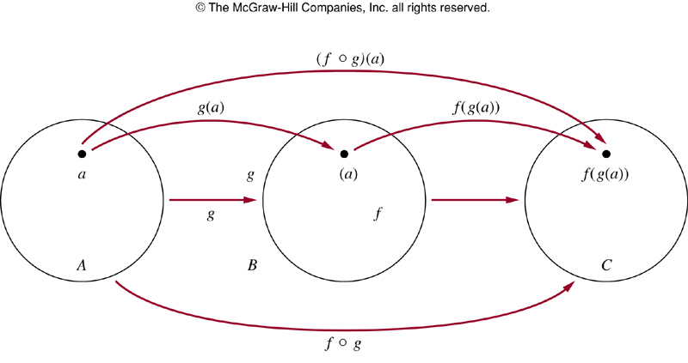
2.3 Functions
Compositions of Functions
Let g be a function from the set A to the set B and let f be a
function from the set B to the set C. The composition of the
functions f and g, denoted by f ° g, is defined by:
f ° g(a) = f (g(a))
Note:
f ° g can’t be defined unless the range of g is a subset of the domain of f.

Slide 63
2.3 Functions
〖Example 5〗 f(x) = 2x + 3, g(x) = 3x + 2.
What is the composition of f and g?
What is the composition of g and f?
f ° g(x) =f (g(x)) = f (3x+2)
= 2(3x+2)+3 = 6x+7
g ° f(x) =g (f(x)) = g(2x+3)
= 3(2x+3)+2 = 6x+11

Slide 64
2.3 Functions
5. Some Important Functions
The floor function
The ceiling function

Slide 65
2.3 Functions
【Definition 】The floor function f (x) is the largest integer less than or equal to the real number x.
Notation:
⎣ x ⎦
For example:
⎣0.5⎦ =
The floor function is often also called the greatest integer function. It is often denoted by [x].
0
⎣1.5⎦ =
1
⎣2⎦ =
2
⎣-0.5⎦ =
−1

Slide 66
2.3 Functions
【Definition 】The ceiling function f (x) is the smallest integer greater than or equal to the real number x.
Notation:
⎡ x ⎤
For example:
⎡0.5 ⎤ =
1
⎡1.5 ⎤ =
2
⎡2 ⎤ =
2
⎡-0.5 ⎤ =
0

Slide 67
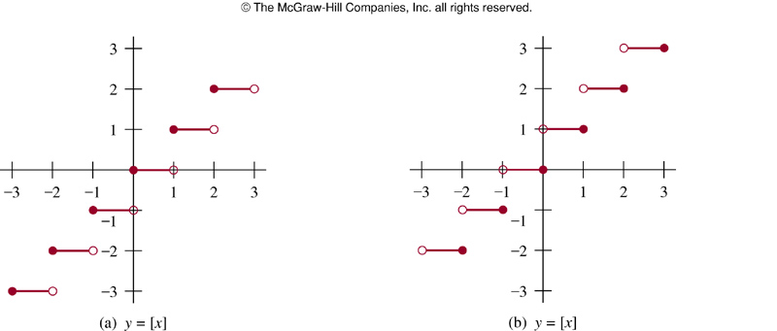

Slide 68
2.3 Functions
Useful Properties of the Floor and Ceiling Functions
(1a) ⎣ x ⎦ = n iff n ≤ x < n + 1 where n is an integer
(1b) ⎡ x ⎤ = n iff n – 1 < x ≤ n where n is an integer
(1c) ⎣ x ⎦ = n iff x – 1 < n ≤ x where n is an integer
(1d) ⎡ x ⎤ = n iff x ≤ n < x + 1 where n is an integer
(2) x – 1 < ⎣ x ⎦ ≤ x ≤ ⎡ x ⎤ < x + 1
(3a) ⎣ -x ⎦ = - ⎡ x ⎤
(3b) ⎡ -x ⎤ = - ⎣ x ⎦
(4a) ⎣ x + m ⎦ = ⎣ x ⎦ + m where m is an integer
(4b) ⎡ x + m ⎤ = ⎡ x ⎤ + m where m is an integer

Slide 69
Proving Properties of Functions
Example: Prove that x is a real number, then
⌊2x⌋= ⌊x⌋ + ⌊x + 1/2⌋
Solution: Let x = n + ε, where n is an integer and 0 ≤ ε< 1.
Case 1: ε < ½
2x = 2n + 2ε and ⌊2x⌋ = 2n, since 0 ≤ 2ε< 1.
⌊x + 1/2⌋ = n, since x + ½ = n + (1/2 + ε ) and 0 ≤ ½ +ε < 1.
Hence, ⌊2x⌋ = 2n and ⌊x⌋ + ⌊x + 1/2⌋ = n + n = 2n.
Case 2: ε ≥ ½
2x = 2n + 2ε = (2n + 1) +(2ε − 1) and ⌊2x⌋ =2n + 1, since 0 ≤ 2 ε - 1< 1.
⌊x + 1/2⌋ = ⌊ n + (1/2 + ε)⌋ = ⌊ n + 1 + (ε – 1/2)⌋ = n + 1 since 0 ≤ ε – 1/2< 1.
Hence, ⌊2x⌋ = 2n + 1 and ⌊x⌋ + ⌊x + 1/2⌋ = n + (n + 1) = 2n + 1.

Slide 70
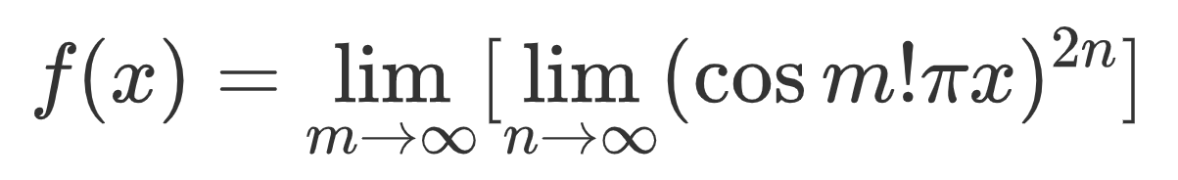
f(x)在x为有理数时总为1，在x为无理数时总为0。

